Slide 1






EPR Digital Service
Validated in February 2023
Notes:
Welcome – Nele Leosk
Yolanda TIME: 20 seconds
By a show of hands, how many people here look forward to doing their taxes?
[Wait for people to raise their hands]
Or enjoy trying to navigate government benefits online?
[Wait for people to raise their hands]

Slide 2
Content
GovStack Country Engagement Journey
GovStack Use Case - Extended Producer Responsibility
EPR Digital Service (Validated in February 2023)
Next steps
DPG selection
Use case documentation in GitBook
Development of functional prototype

Slide 3
Acronyms & definitions
Definition:
Extended Producer Responsibility: OECD defines Extended Producer Responsibility (EPR) as an environmental policy approach in which a producer’s responsibility for a product is extended to the post-consumer stage of a product’s life cycle. An EPR policy is characterised by: (1) the shifting of responsibility (physically and/or economically; fully or partially) upstream toward the producer and away from municipalities; and (2) the provision of incentives to producers to take into account environmental considerations when designing their products.
Institutions / Departments:
ORG: Office of the Registrar General
OSC: One Stop Centre
PSF: Private Sector Federation
RDB: Rwanda Development Board
REMA: Rwanda Environment Management Authority
RICA: Rwanda Inspectorate, Competition and Consumer Protection Authority
RRA: Rwanda Revenue Authority
RSSB: Rwanda Social Security Board
RURA: Rwanda Utility Regulatory Authority
Others:
EPR: Extended Producer Responsibility
eTax: RRA’s portal to obtain tax and social security contribution clearance

Slide 4
Country Validation Team
RICA
Antoinette Mbabazi, Head of Registration & Licensing ______________________________
Robert Mugisha, Director of Registration & Licensing ______________________________
Longin Dusengeyezu, Database & Applications Administrator __________________________
Validation date: Feb 2023

Slide 5


`
Initiation
Stage 1
Stage 2
Stage 3
Stage 4
Awareness Building & Expression of Interest.
Agreement of Cooperation
GovStack Internal Kick-off
Country Kick-off
Stage 5
Stage 6
Stage 7
Stage 8
Stages of
Implementation
Understanding Country Context & Needs
Institutional governance & digital team
GERA* & Share Service Policy
Services prioritisation & ranking
Co-Design
&
Delivery
Stage 9
Digital Government Service Co-Design & Delivery
Stage 9.1
Stage 9.2
Stage 9.3
Stage 9.4
Understand user needs, life events & detail ‘As-Is’ user journey
Design the ‘To-Be’ user Journey to develop prototype wireframe
Develop Product and Technical Specifications for use e-service use case GovStack compliant BBs & DPGs
Implementation of functional prototype on the GovStack Sandbox
Stage 10
Stage 11
Scale**
Handover prototype to partner government & GovStack Experience journal
GovStack Excellence Center
scale, sustain, monitor
* Government Enterprise Reference Architecture **Government digital team further implements GovStack BB approach based on the experience gained by digitising 1 or 2 high demand services

Slide 6







Rwanda EPR digital service digitisation roadmap
April 2022
May - July 2022
July - August 2022
Nov 22 - Feb 23
Map As-Is user journey & life/business events
Co-design w/user a To-Be user journey & wireframes
Prioritized government services
Understand user needs
Mar - Apr 2023
May - Oct 2023
TBD
TBD
Select DPG,
Prepare technical specs & architect the service
Prototype & iterate with the user
(GovStack Sandbox)
Launch de service
(always in country infrastructure)
Prepare a scaling strategy & digitalization road map

Slide 7
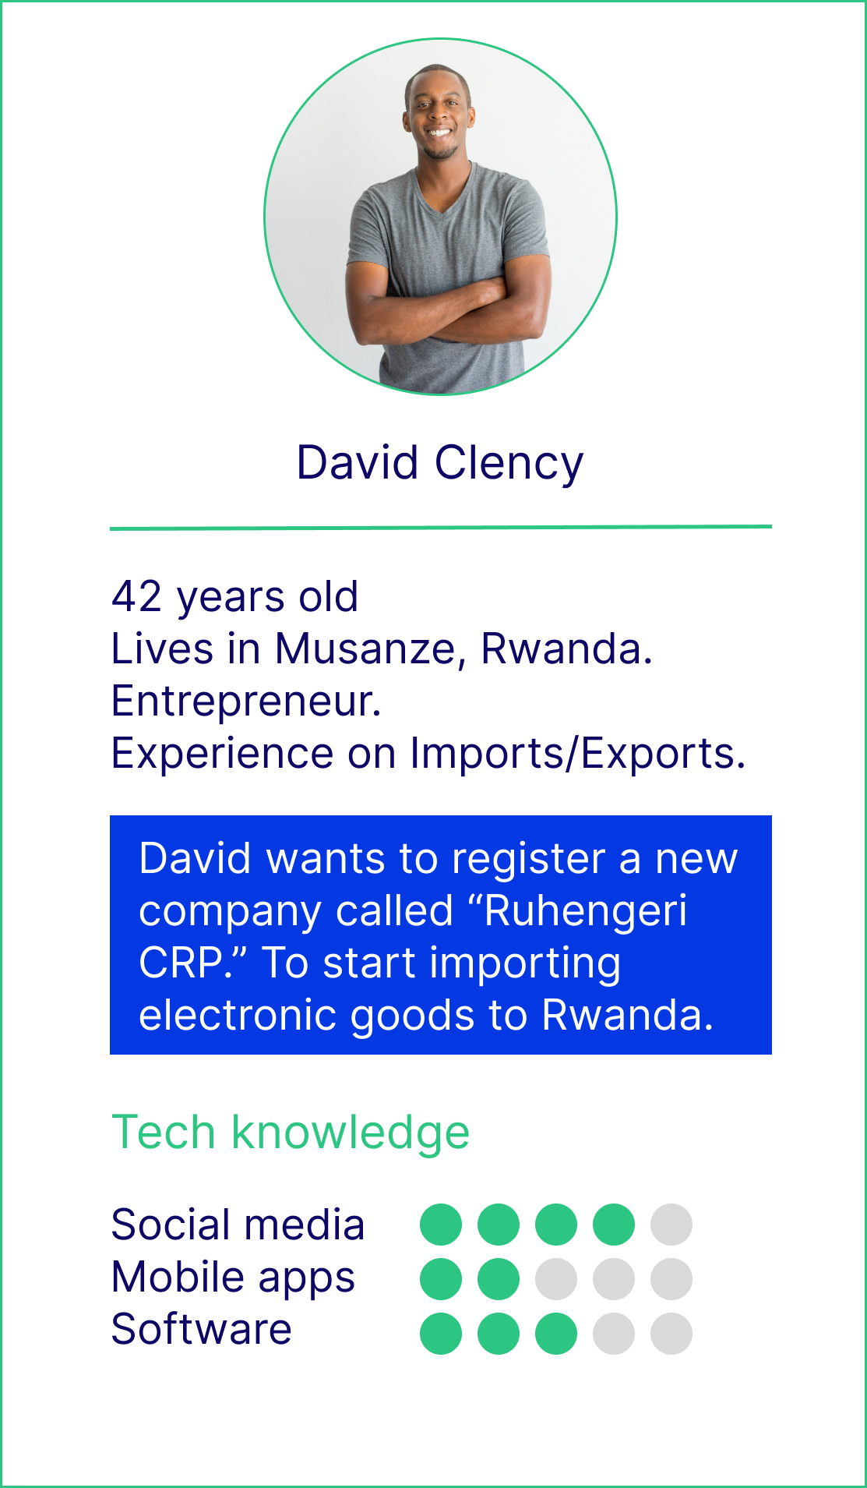

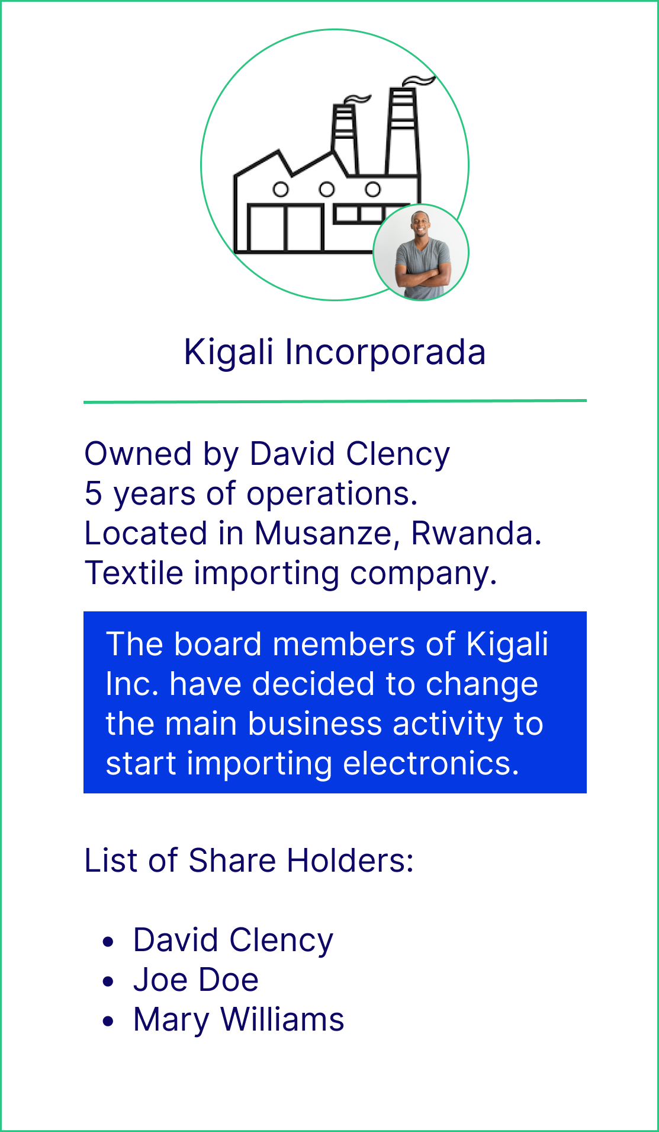
Who are the users of the EPR service in Rwanda?
3 . Existing business: change in business activities
2 . New business: power of attorney
New business: entrepreneur
Notes:
New business dealing in electronic & electrical equipment
importer, manufacturer
entrepreneur, SME, large company
Existing business dealing in electronic & electrical equipment
importer, manufacturer
entrepreneur, SME, large company
Existing business changing activity
importer, manufacturer
entrepreneur, SME, large company

Slide 8

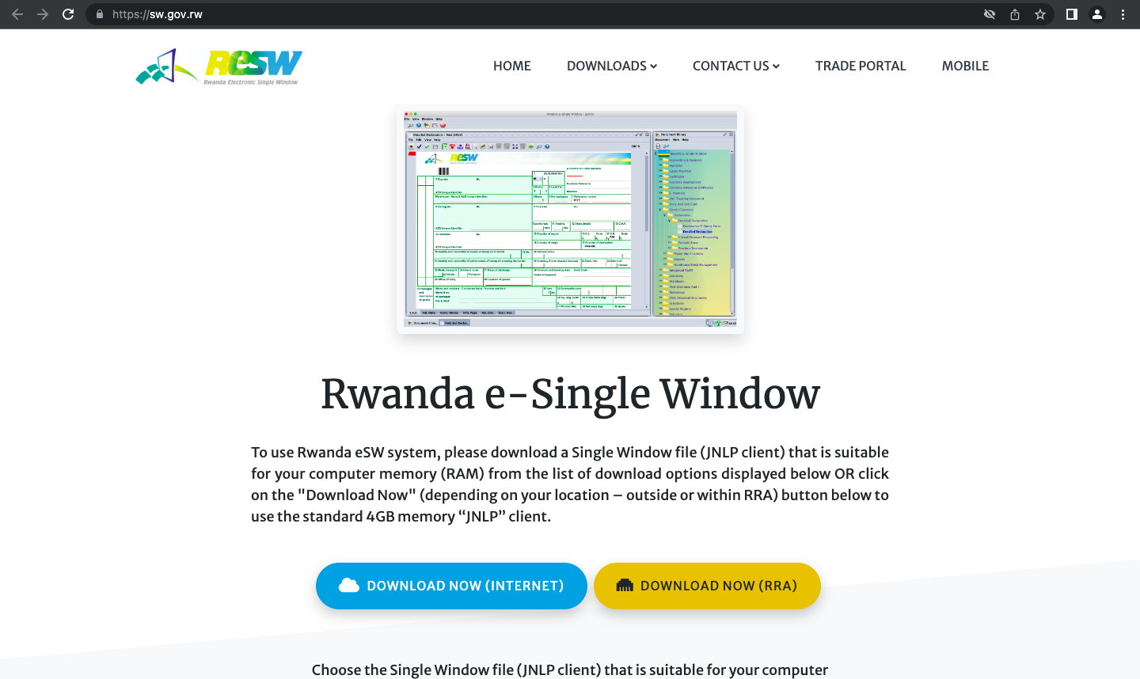
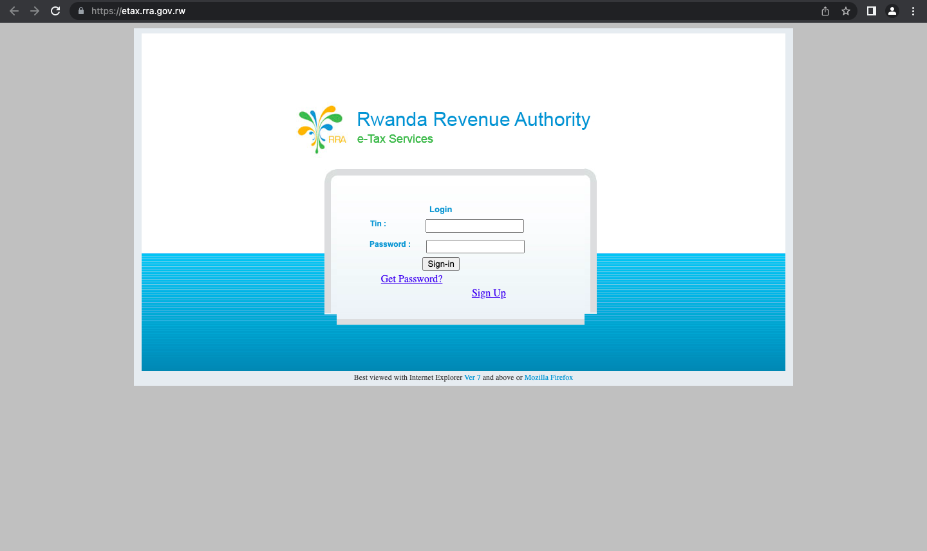
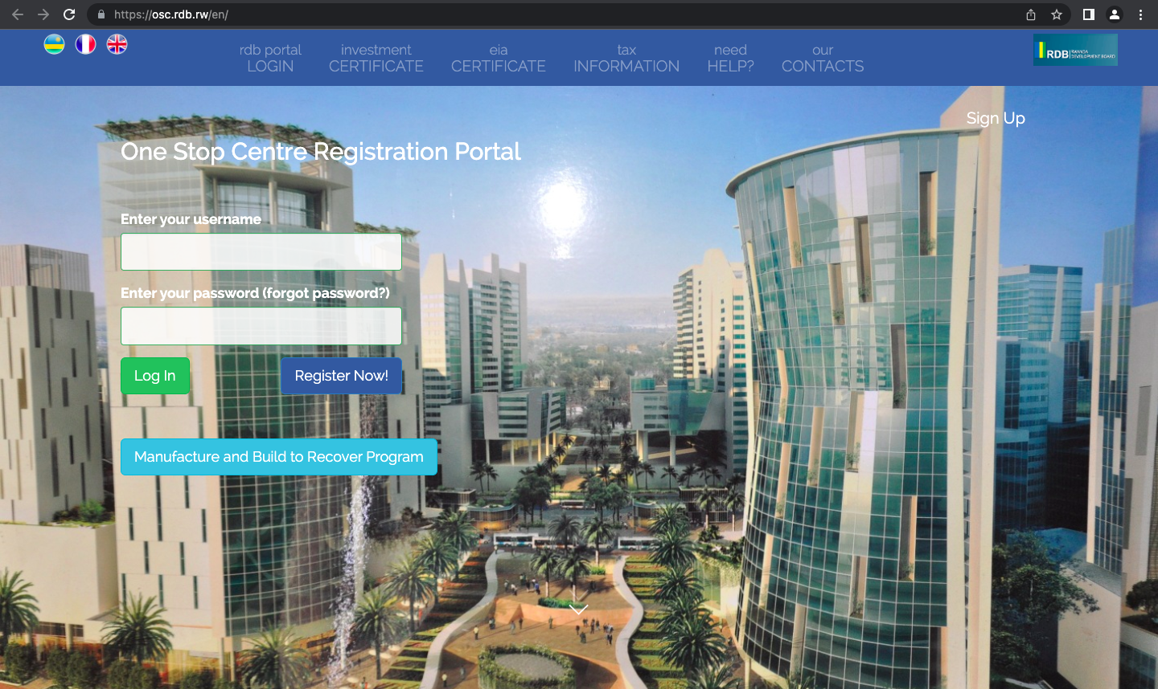
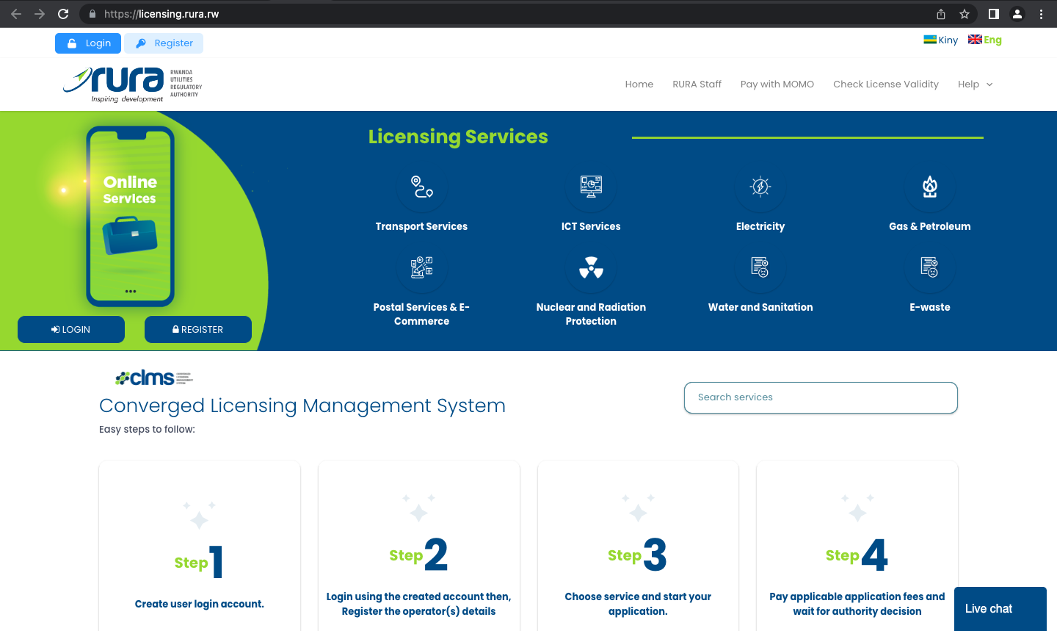
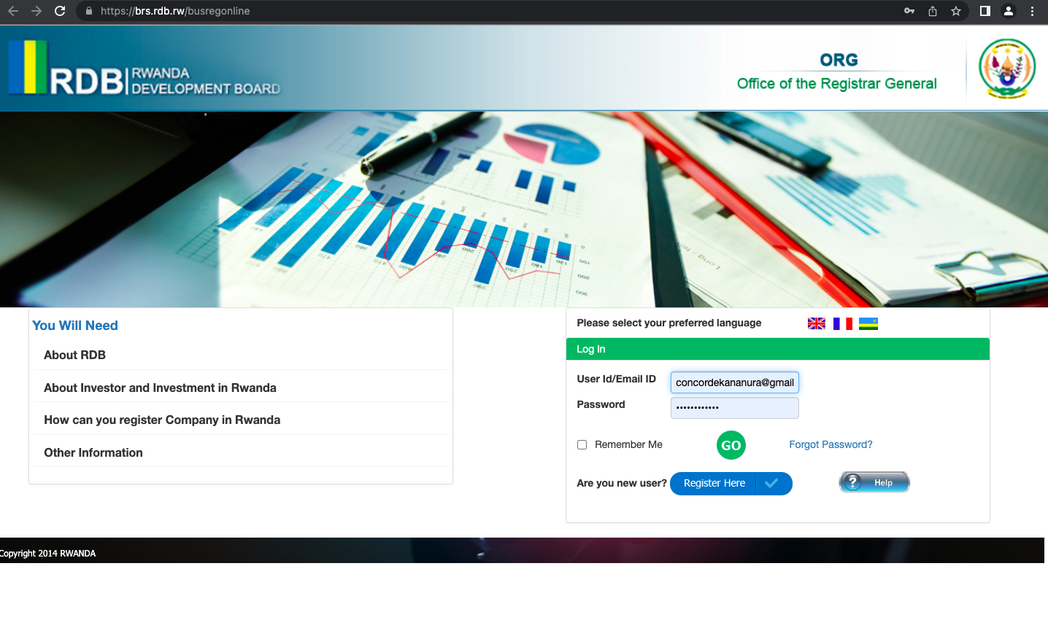
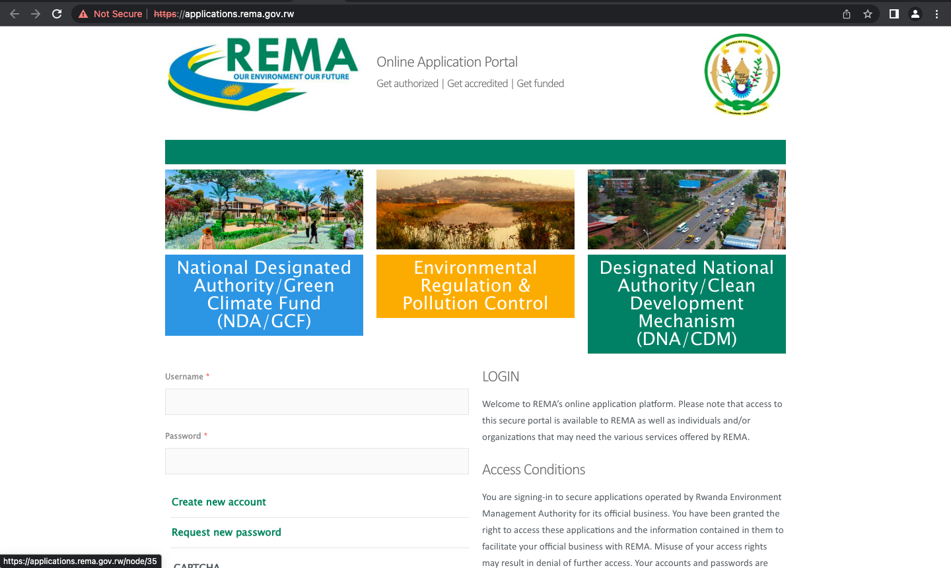
Initial to-be User Journey: Extended Producer Responsibility (Miro)
Service design considering current operating portals (7) will make compliance with the EPR procedure complex
BEFORE THE SERVICE
DURING THE SERVICE
AFTER THE SERVICE
STAGE OF THE JOURNEY
Landing
siloed platforms
Company registration (RDB)
EIA
(RURA) /(OSC)
Tax & SS clearance
(RRA eTax)
Producer license (RICA)
Product registration (RICA)
Type approval (RURA)
ODS (REMA)
MEPS (REMA)
Import permit
(RICA)
Pay EPR fee (PSF)
Authorization
(RURA)
Customs clearance
(RRA eSW)
Citizen satisfaction survey
Social media
ORG portal
OSC portal
RRA eTax
RICA offline
RICA offline
RURA portal
REMA portal
REMA portal
RICA offline
PSF offline
RURA offline
RRA eSW
Various
Citizen to citizen
POINT OF CONTACT
Mass media
Newspaper,radio, tv, PSF
12 different procedures in total
7 can be applied online & 5 are in person
7 different portals, each with different logins & passwords
COMPLEXITY

Slide 9



To address a silo approach we propose a single window end to end experience
RDB
Company registration
RICA
A single window approach integrate a seamless experience to complete a government service end to end across different gov departments
Producer license, product registration, import permit
RURA
Users
Type approval
REMA
ODS, MEPS
eTax
Implemented using a reusable registration/registry BB
clearance certificates
PSF
EPR fee collection

Slide 10

To address a silo approach we propose a single window end to end experience
RDB
Company registration
RICA
A single window approach integrate a seamless experience to complete a government service end to end across different gov departments
Producer license, product registration, import permit
RURA
Type approval
Users
REMA
ODS, MEPS
eTax
Implemented using a reusable registration/registry BB
clearance certificates
PSF
EPR fee collection

Slide 11
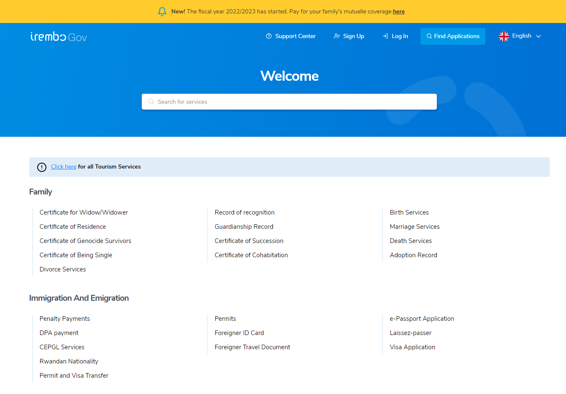
We propose Irembo as one stop shop for EPR service as it offers a unified user experience to access Rwanda government services
1.
2.
3.
It is a mature layer between public institutions that hosts high-quality digital services.
It is already highly utilized and trusted by the citizens. The plans to expand the number of services offered in Irembo makes it the best candidate to host the services that are still in development process (like the EPR).
The reduction of frictions and obstacles for the user to access a service needs to be minimized. Currently, there are more than 7 digital platforms in need of maintenance to host business-related digital services. Each of them with their individual shortcomings.

Slide 12
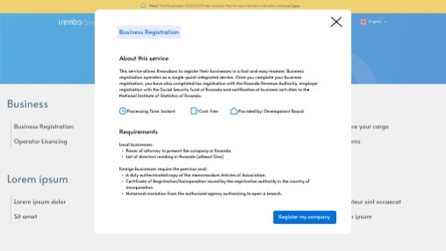
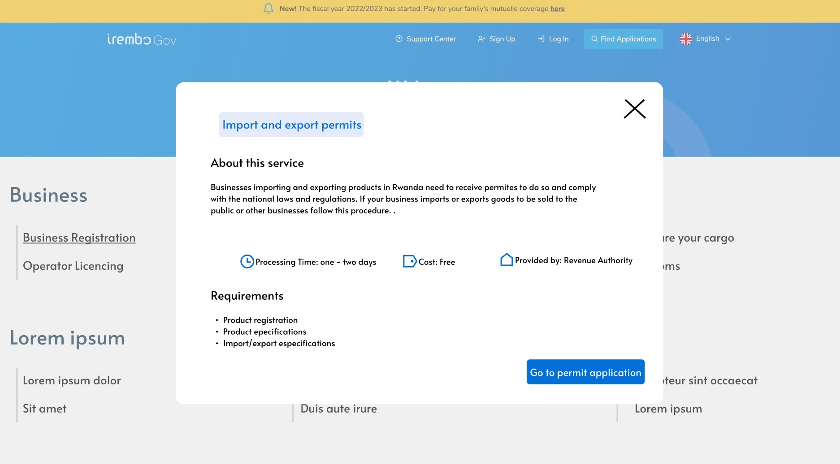
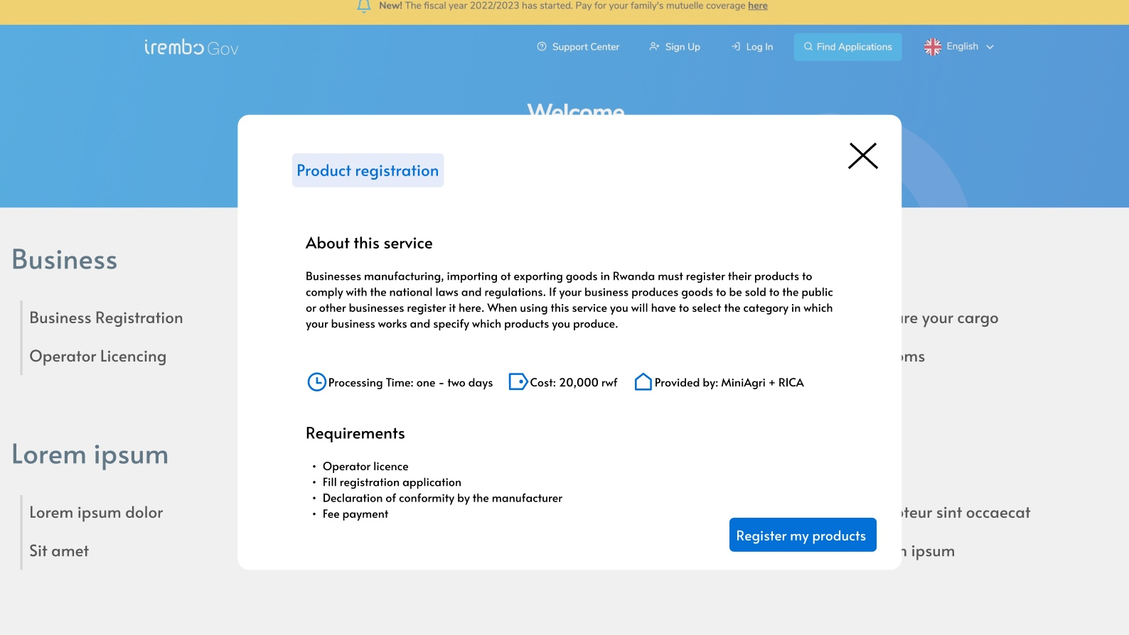
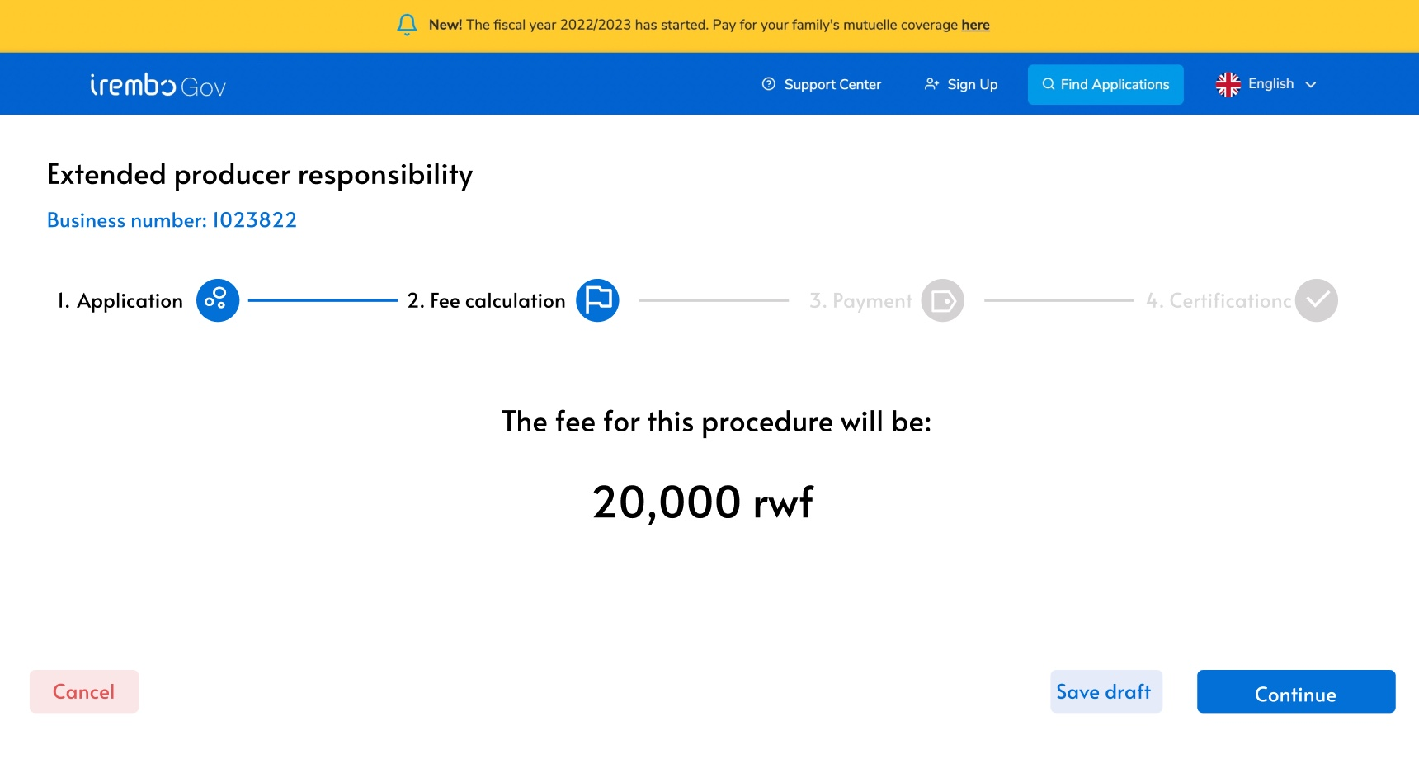
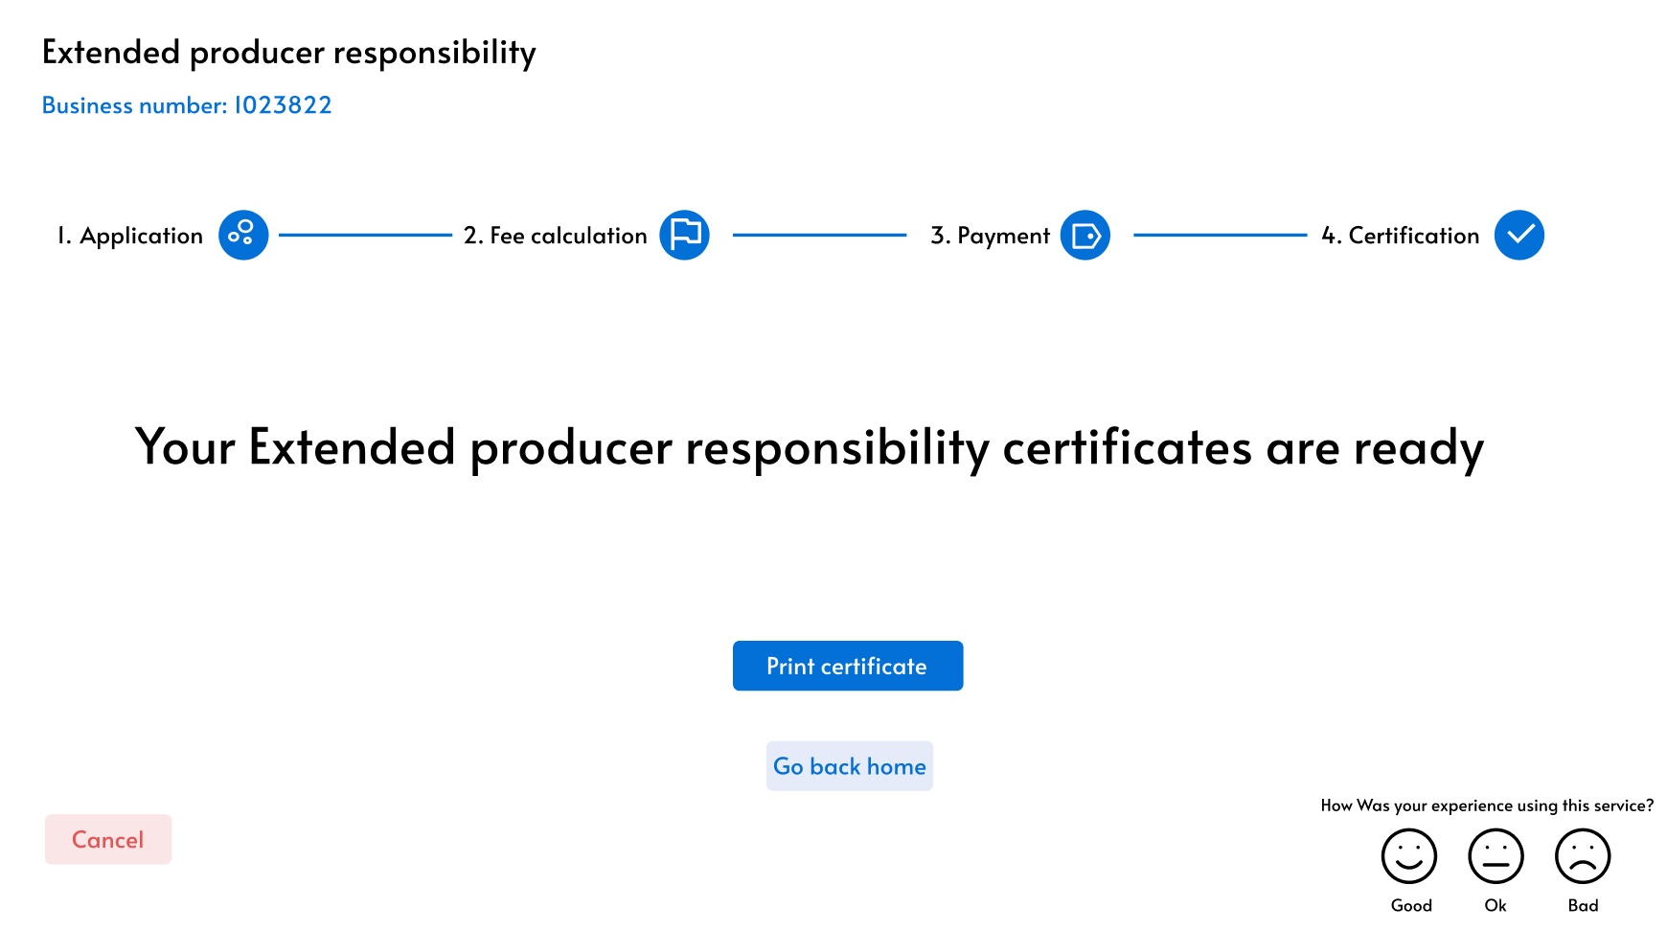
User journey 1: New business dealing in electrical & electronic equipment (Miro)
BEFORE THE SERVICE
DURING THE SERVICE
AFTER THE SERVICE
STAGE OF THE JOURNEY
Landing Irembo / Business
Simultaneous application:
Company registration,
Producer license, Payment
Environmental Assessment
Simultaneous application:
Product registration, Type approval, ODS & MEPS, Payments
Import permit
EPR fee payment
Citizen satisfaction survey
Social media
irembo.gov.rw
irembo.gov.rw
irembo.gov.rw
irembo.gov.rw
irembo.gov.rw
irembo.gov.rw
POINT OF CONTACT
Citizen to citizen
Mass media
Newspapers, radio, tv, PSF
Notification to apply for Producer license when business activity is EEE import & manufacture - RICA
Tax & RSSB clearance: integration with eTax database
Payment through irembo
Additional requirements for manufacturer:
if you already have a factory / warehouse: Need an Environmental audit certificate
If planning to build: Environmental Impact Assessment
Notifications per type of product:
Type approval for electronic comm items (RURA)
Ozone Depleting Substances (ODS) (REMA)
Minimum Energy Performance Standards (MEPS) (REMA)
Samples where applicable
Payment trough irembo
Only requirements:
Product code
Quantity
Other requirements have been submitted at product registration
1. Instant payment alert in PSF system
2. PSF validates the payment for RURA to issue authorisation
4. RURA issues authorisation
5. Authorisation is reflected in customs eSW
6. Payment through irembo
Citizens satisfaction survey is a reusable forms/registry that must be incorporated in all services launch under the Irembo digital service standard
SIMPLIFICATIONS
Detailed simplifications here

Slide 13
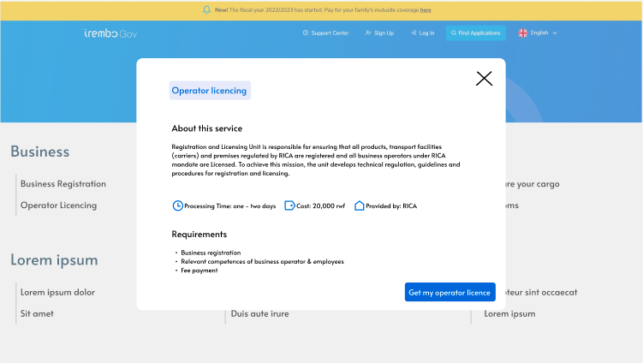
User journey 2: Existing business already dealing in electrical & electronic equipment (Miro)
BEFORE THE SERVICE
DURING THE SERVICE
AFTER THE SERVICE
STAGE OF THE JOURNEY
Landing Irembo / Business
Simultaneous application:
Producer license, EA & payment
Simultaneous application: Product registration, Type approval, ODS & MEPS
Import permit
EPR fee payment
Citizen satisfaction survey
Social media
irembo.gov.rw
irembo.gov.rw
irembo.gov.rw
irembo.gov.rw
irembo.gov.rw
POINT OF CONTACT
Citizen to citizen
Mass media
Newspapers, radio, tv
Additional requirements for manufacturer:
if you already have a factory / warehouse: Need an Environmental audit certificate
If planning to build: EIA
Tax & RSSB clearance: integration with eTax DB
Payment through irembo
Notifications per type of product:
Type approval for electronic comm items (RURA)
Ozone Depleting Substances (ODS) (REMA)
Minimum Energy Performance Standards (MEPS) (REMA)
Samples where applicable
Payment trough irembo
Only requirements:
product code
quantity
Other requirements have been submitted at product registration
1. Instant payment alert in PSF system
2. PSF validates the payment for RURA to issue authorisation
4. RURA issues authorisation
5. Authorisation is reflected in customs eSW
6. Payment through irembo
Citizens satisfaction survey is a reusable forms/registry that must be incorporated in all services launch under the Irembo digital service standard
SIMPLIFICATIONS
Detailed simplifications here

Slide 14
User journey 3: Existing business changing activity to electrical & electronic equipment (Miro)
BEFORE THE SERVICE
DURING THE SERVICE
AFTER THE SERVICE
STAGE OF THE JOURNEY
Landing Irembo / Business
Simultaneous application:
Change of business activity, Producer license, & Payment
Environmental Assessment
Simultaneous application: Product registration, Type approval, ODS & MEPS
Import permit
EPR fee payment
Citizen satisfaction survey
Social media
irembo.gov.rw
irembo.gov.rw
irembo.gov.rw
irembo.gov.rw
irembo.gov.rw
irembo.gov.rw
POINT OF CONTACT
Citizen to citizen
Mass media
Newspapers, radio, tv
Notification to apply for Producer license when business activity is EEE import & manufacture - RICA
Tax & RSSB clearance: integration with eTax database
Payment through irembo
Additional requirements for manufacturer:
if you already have a factory / warehouse: Need an Environmental audit certificate done by a third party
If planning to build: Environmental Impact Assessment
Notifications per type of product:
Type approval for electronic comm items (RURA)
Ozone Depleting Substances (ODS) (REMA)
Minimum Energy Performance Standards (MEPS) (REMA)
Samples where applicable
Payment trough irembo
Only requirements:
product code
quantity
Other requirements have been submitted at product registration
1. Instant payment alert in PSF system
2. PSF validates the payment for RURA to issue authorisation
4. RURA issues authorisation
5. Authorisation is reflected in customs eSW
6. Payment through irembo
Citizens satisfaction survey is a reusable forms/registry that must be incorporated in all services launch under the Irembo digital service standard
SIMPLIFICATIONS
Detailed simplifications here

Slide 15


High level architecture of the service - to be detailed in product & tech workshops with RISA
Citizen portal unified xperience
Irembo.gov.rw
ID
CMS
Consent
WF
Workflow (WF)
IM
Information Mediator (IM)
Citizen satisfaction survey Registry/DB
Payment gateway*
Business registry
(RDB)
RICA Registry
Producer licensing
Product registration
Import permit
RURA Registry
Type approval
EPR authorisation
REMA registry
EIA
ODS
MEPS
Registration
PAY
Registry
Registration
Registry
Registry
BB already in place, ID, Digital Signature, Payment, Registries, IM,
New BB - Registration RICA to accommodate more than agriculture products. EPR Product registration, producer license and import permits, WF, Satisfaction survey
*Note: One payment gateway, two different bank accounts - RICA (2 payments), Private Sector Federation (1)

Slide 16
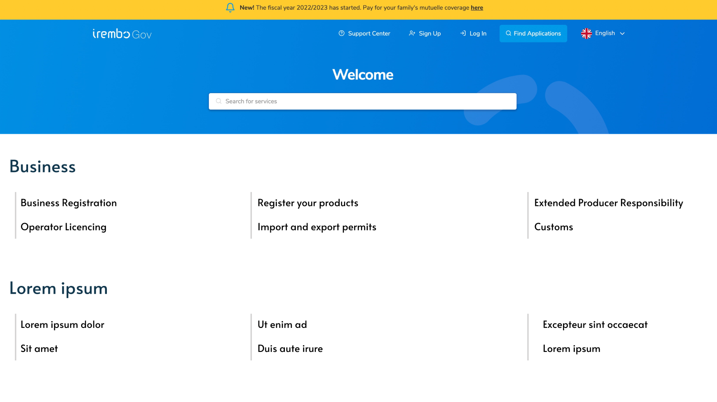
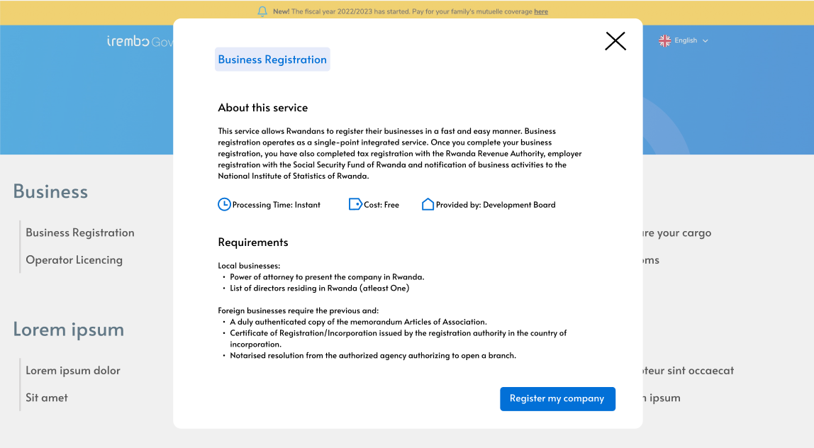
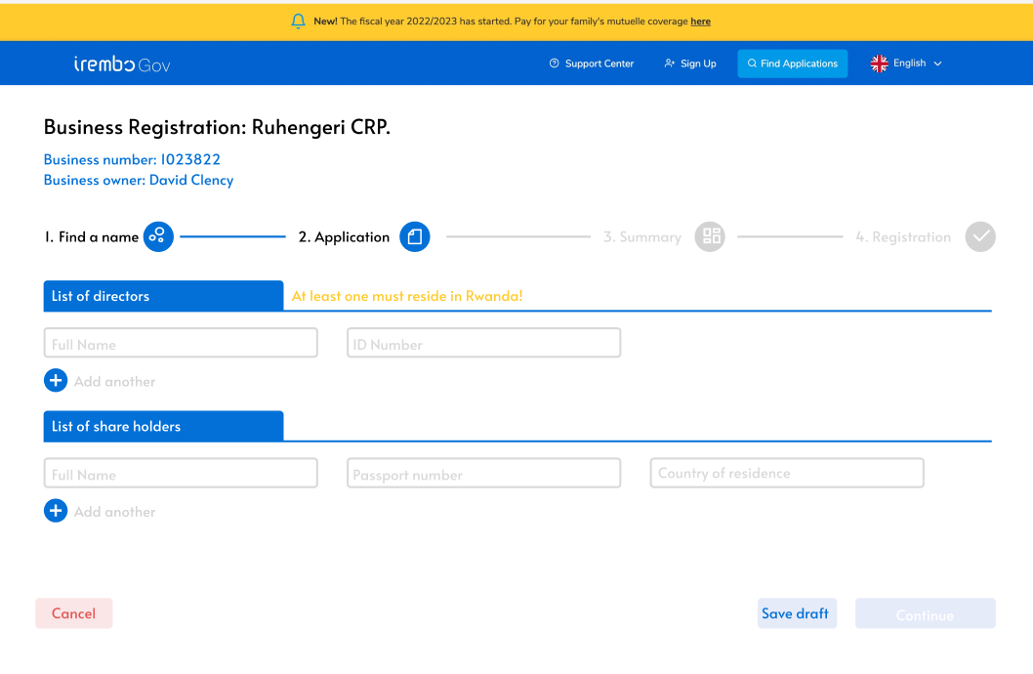
One option for developing the EPR service is the reusable eRegistration/eRegistry one stop shop model
Unified seamless User Experience
Irembo
Business section in Irembo
Information Sheet
When the user clicks the start service, they transact to UNCTAD e-Registration platform
Reusable Registration BB to act as single window- Same UX-IU as Irembo
Single sign on
No code Unified form that connects to:
Business registry
Irembo payment gateway
Land Registry,
eTax DB, RURA, REMA, eSW

Slide 17

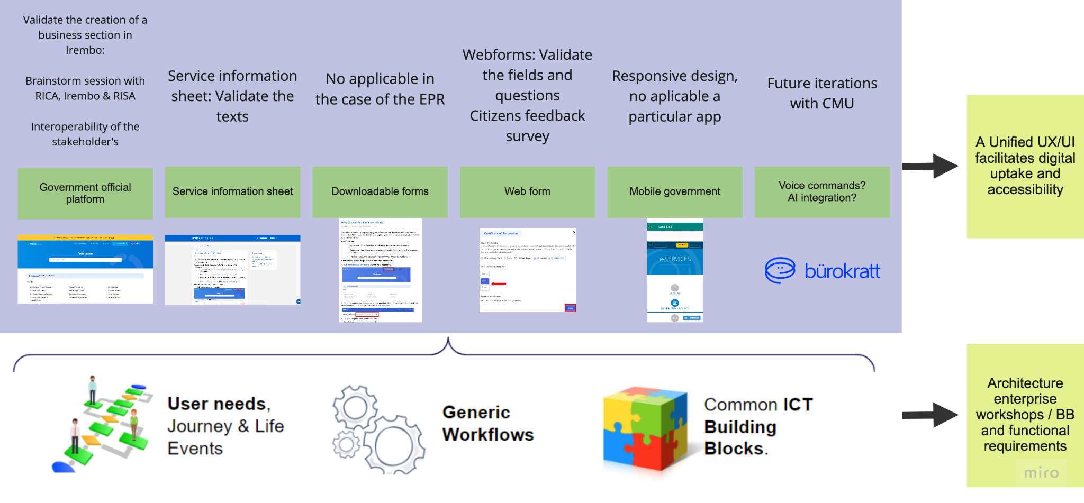



Next steps
Validate the creation of business section in Irembo:
Brainstorm session with RICA, Irembo and RISA
Interoperability of the stakeholders
Service information sheet: Validate the texts
Not applicable in the case of EPR
Webforms: Validate the fields and questions citizens feedback survey
Responsive design, no applicable particular app
Future iterations
with CMU
Government official platform
Service information sheet
Downloadable Forms
Web Forms
Mobile Government
Voice commands & AI integration
A unified UX/UI facilitates digital uptake & accessibility
User needs, Journey & Life Events
Common ICT Building Blocks.
Reference enterprise architecture & BB tech specs
Generic Workflows

Slide 18
Next steps
Action | Date | Responsible entity
Validate the creation of a business section in Irembo front page Validate the creation of a business section in RRA eSW front page | 22-12-2022 22-12-2022 | RICA - Olivier RICA - Olivier
Validate the texts in service information sheet | 31-01-2023 | RICA - Longin
Validate the fields and questions | 31-01-2023 | RICA - Longin
Citizens feedback survey - Validate questions |  | RICA/IREMBO/RRA
Product & Architecture workshops/BB Validate current state of their Stack - ID, Payments, CMS-Irembo, IM - Interoperability requirements (ID, Land Registry, Business Registries, eTax DB, RURA portal, REMA portal, eSW) Validate structure of the APIs, data currently exchanged Analyze options for registration platform in RICA Analyze options with Work Flow (WF) | Feb/2023 | RICA - Olivier RISA - Thomas & Elisabeth Irembo - invite by RISA (Elisabeth)
Use GovStack sandbox for prototype testing? YES |  | RICA/ITU

Slide 19
Annex

Slide 20
Irembo for business: User experience and interface
Simplification = Usage = Trust
Irembo is a robust and modern citizen platform.
There is room for improvement before it is ready to host business-related online services.
This improvements can be summarized in:
User friendliness: how simple is it to use? and, is it usable for everyone?
Platform cohesiveness: how seamless is the UX through Irembo as a whole?

Slide 21
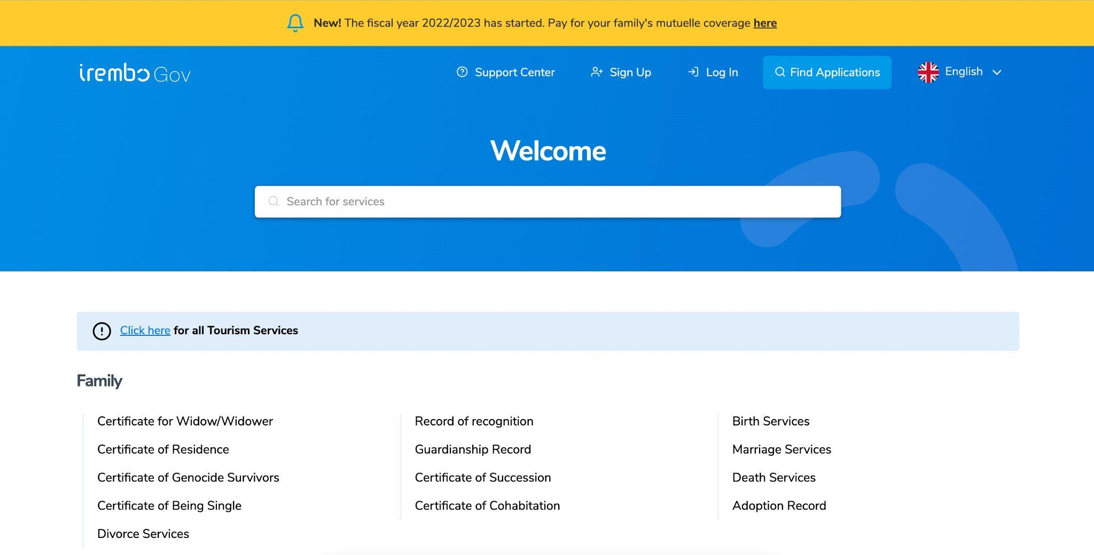
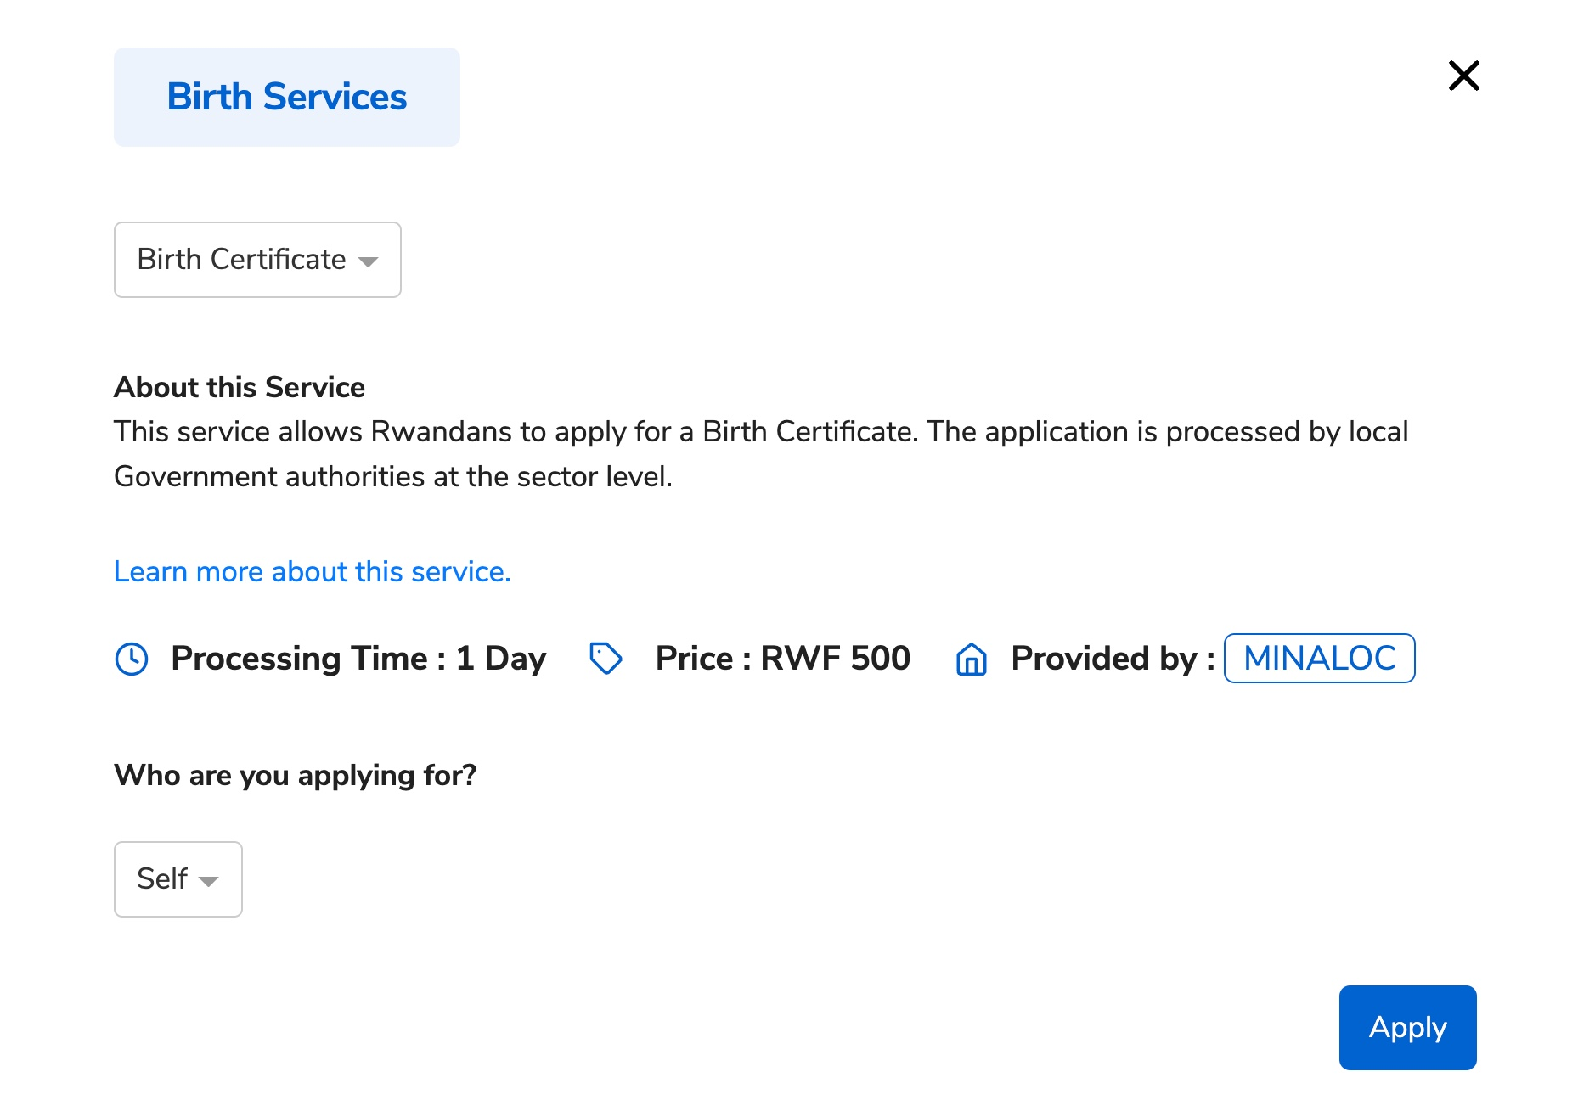
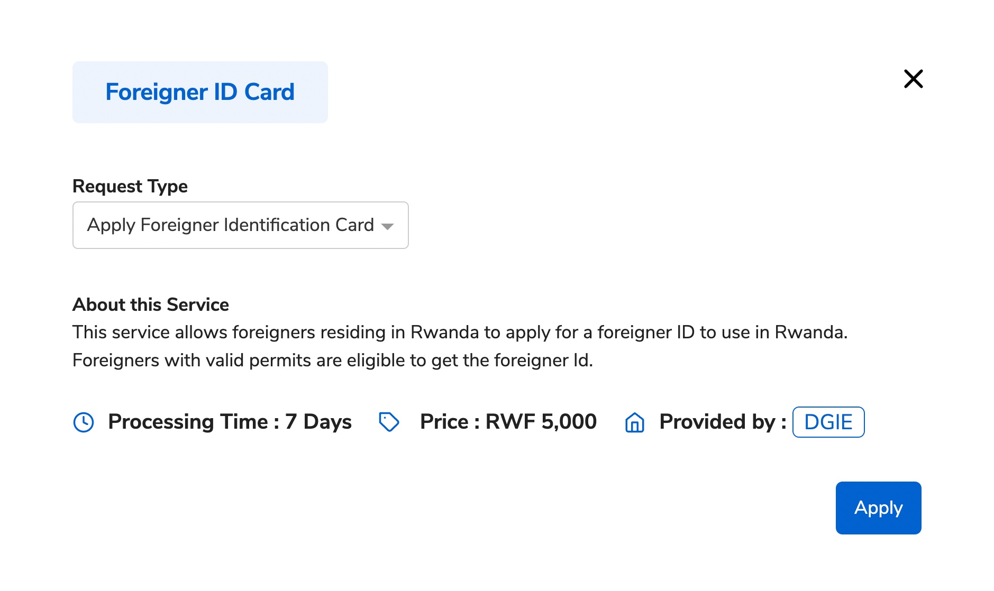
User friendliness
Users need to be aware of Irembo before using it, because it doesn’t explain the purpose of the platform.
Many citizen platforms prioritize the education of the user, and provide a small but effective explanation of what the platform does.
Each service has different requirements that will affect the possibility of the user to access it.
These should be easily accessible and visible.
Only some services include a “learn more” link that shows the requirements.

Slide 22
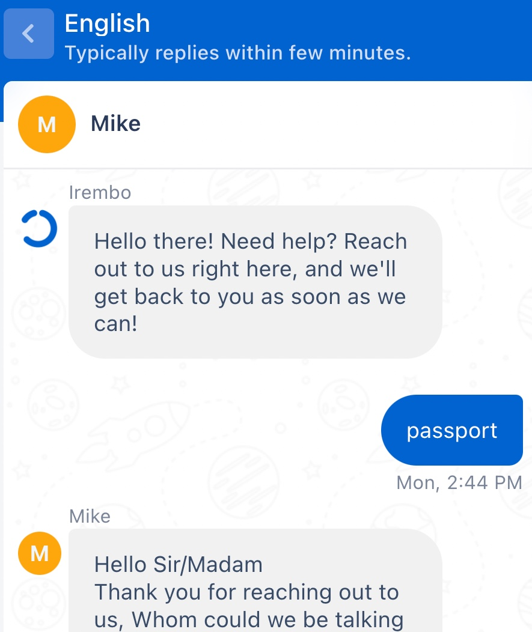

User friendliness
Notifications system has a different purpose than the platform “News”
Some functionalities are not always accessible.
There is no operational difference between the live chat and the “submit a ticket” functionality.
The live chat is useful, but not always necessary.
The time spent waiting for an answer from an agent, can be replaced by a chat bot. This chatbot could redirect the user to an agent when needed.
The same chatbot can collect the necessary user information for filling a ticket.
An assessment would be useful to ensure the platform complies with the Web accessibility standards W3C

Slide 23
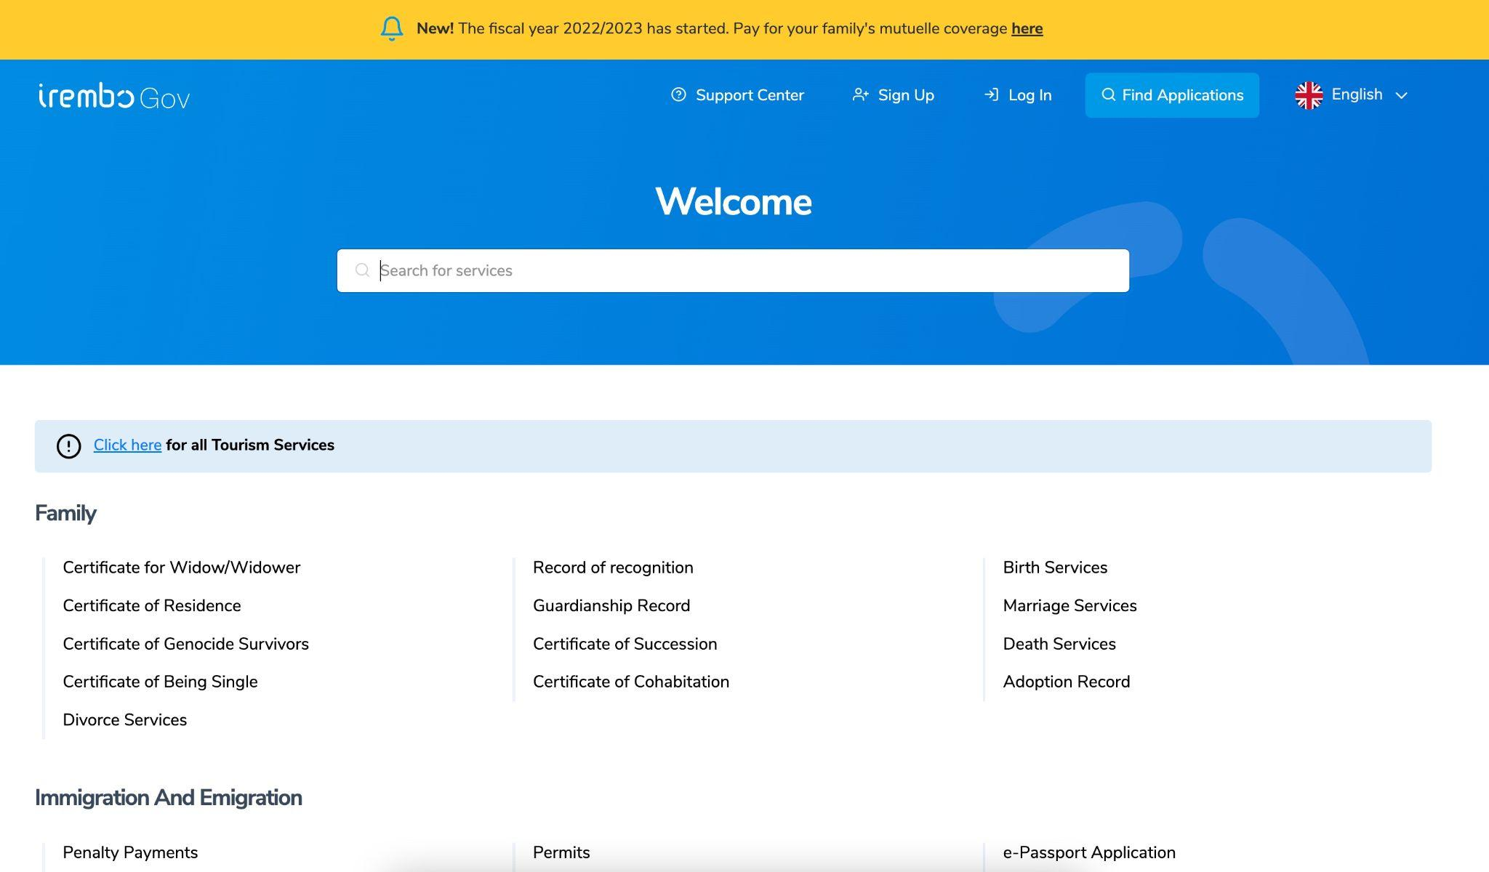
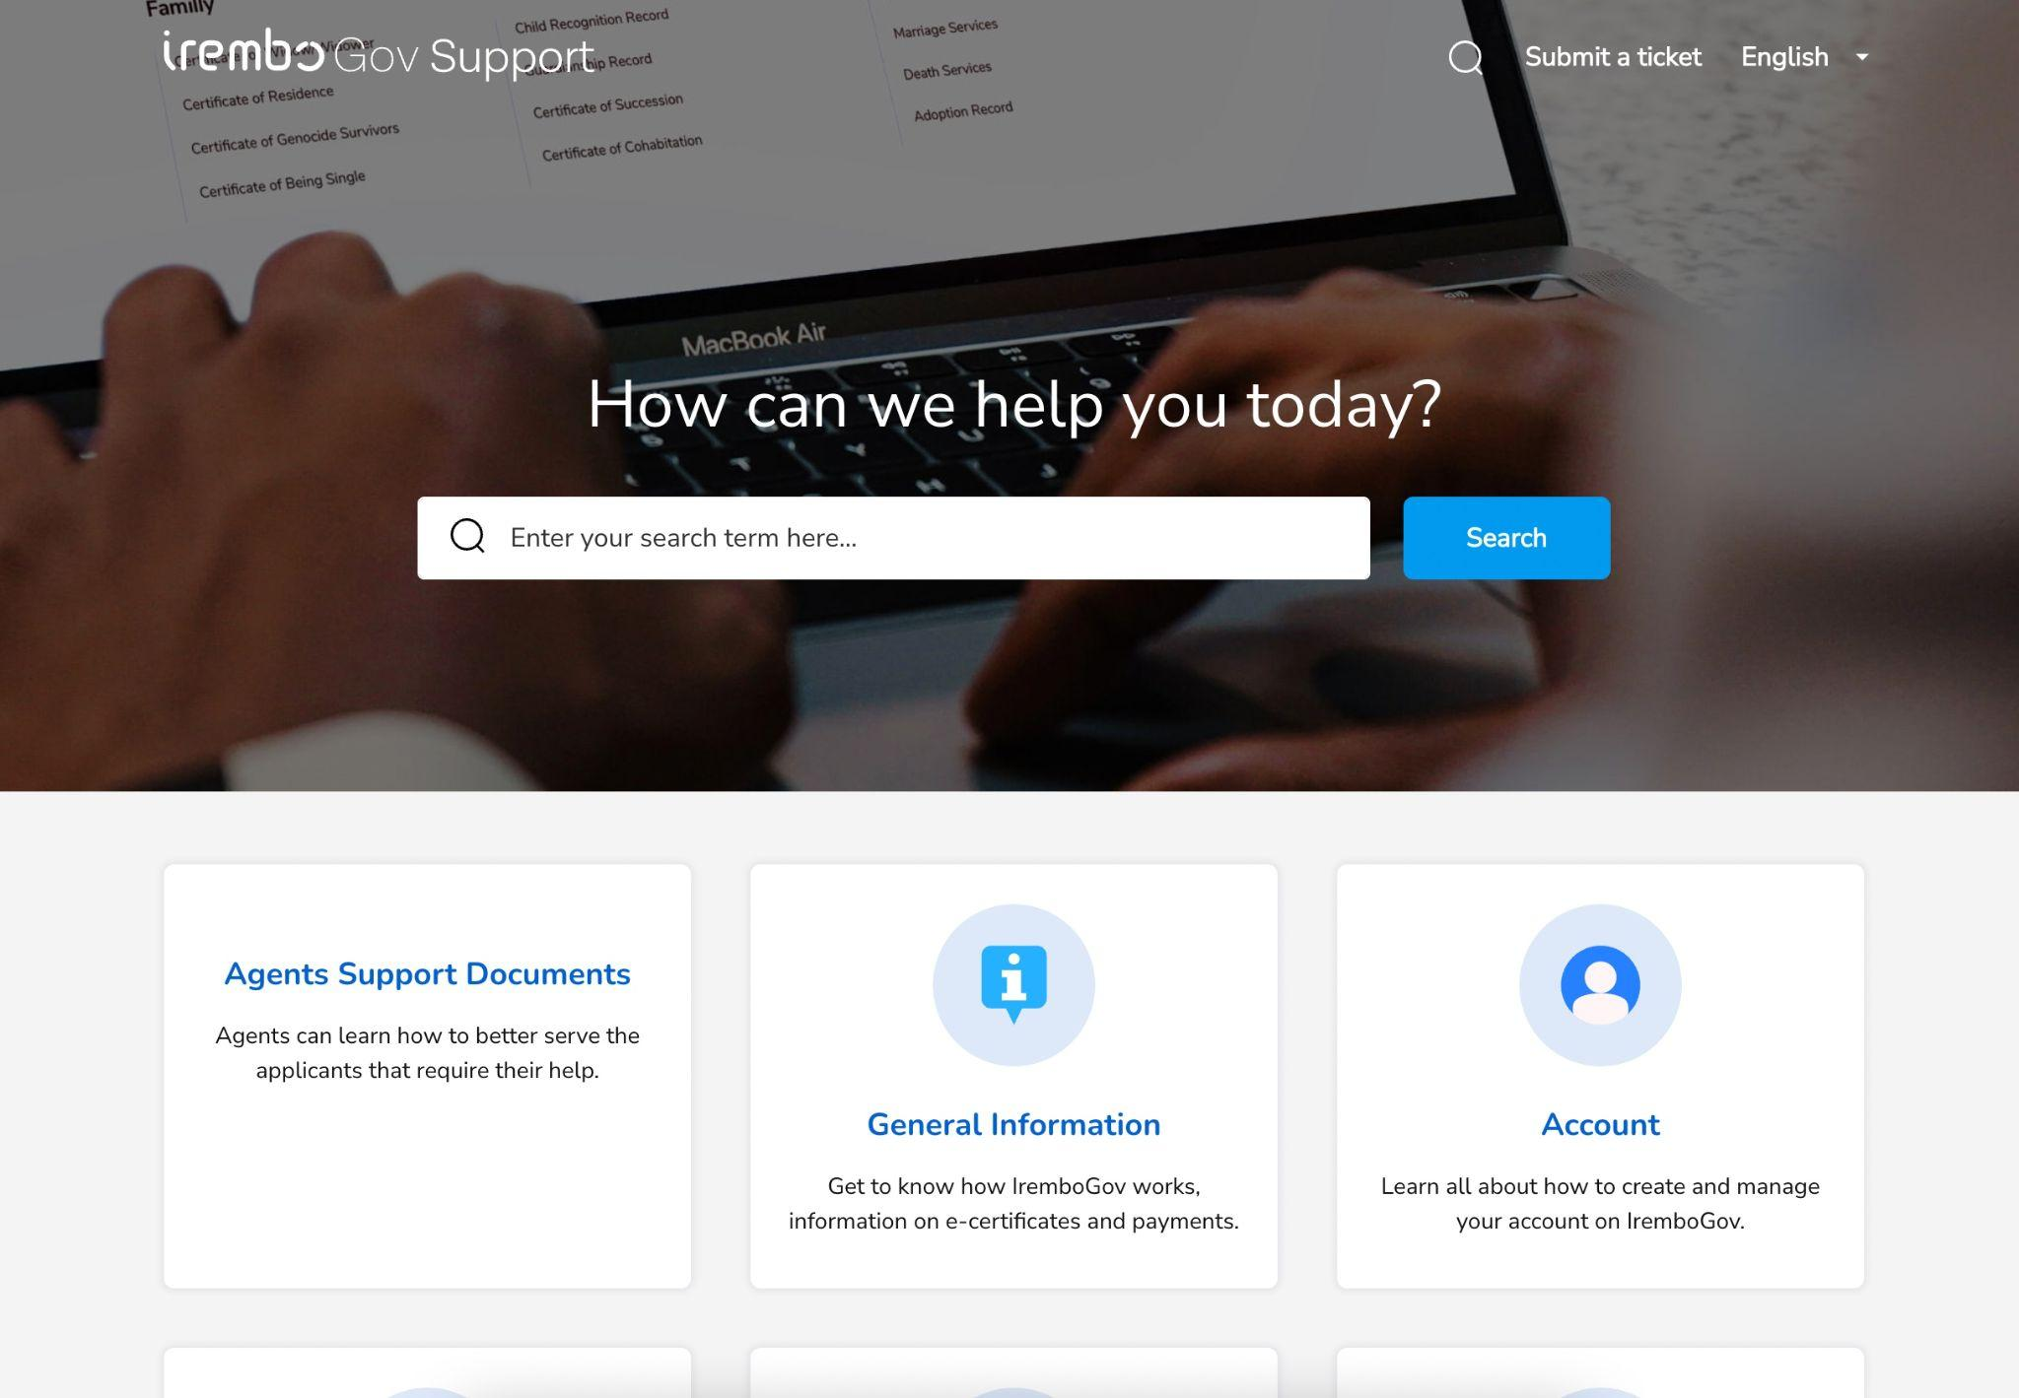
Platform cohesiveness
There are two search bars in the main page, this is confusing for first time and not logged-in users.
Irembo main page and Irembo support feel like different platforms.
The main differences are perceived in: fonts, colors, icons, and the general web-page design.

Slide 24
Next steps

Slide 25
Digital public good to be considered to enable the EPR
Registration BB scope
Registration BB
Other GovStack BB
User Interface
(capture data) and process flow
Examples:
Digital registries BB;
Payment BB
Digital Identity BB
Existing GOV systems
Consent management
Messaging,
Scheduling
Workflow
E-service
Register
Consult
Information Mediator BB
Secure data exchange
API
Modify
Cancel
Notes:
Standardized, plug and play to interconnect external systems with OpenAPI.
IM is like a glue to connect different systems.

Slide 26
Digital public good to be considered to enable the EPR
Digital Registries scope
GovStack BB
Digital Registries BB
User Interface and flow (capture data)
DATA STORAGE
E-service
Register
Internet
Create
Data
Admin
Tools
e-services portal,
Back office system,
Microservice
Consult
Information Mediator BB
Secure standardized data exchange
Read
API
Modify
Update
Schema
Schema
Tools
Cancel
Delete
Notes:
Combine like the LEGO blocks.

Slide 27
Adopted simplifications: Simultaneous Business registration + Producer license + payment
 | Current draft procedure | Proposed procedure
Number of steps | 6 | 4
Steps | 1.Submit application for business registration 2. Obtain company registration certificate 3. Pay licensing fee 4.Submit application for license 5.Premises inspection (RICA) 6.Obtain business operator license | 1.Submit application for business registration 2.Obtain business registration certificate & Producer license Additional if EIA required 3. Submit study report 4. Obtain EIA
Rationale | Simultaneous application if business activity is manufacture or import of EEE. Payment should be part of the application process since it’s done in one iteration when the process is digitised. Premises inspection would be a duplication if producers are required a site visit during EIA process (REMA). RICA and REMA could share information so only one institution does the site visit, where necessary.
Requirements | 9 | 2
 | 1.Payment receipt 2.Application form 3.Certificate of domestic company registration 4.Operational license where applicable 5.Proof of relevant competences of the business operator or of the employees 6.Environmental impact assessment 7.Site approval 8.Tax clearance certificate 9.RSSB contributions clearance certificate | 1.Proof of relevant competences of the business operator or of the employees 2.Additional requirements for manufacturer: if you already have a factory / warehouse: Need an Environmental audit certificate if planning to build a factory / warehouse: Need an Environmental Impact Assessment (EIA)
Rationale | Payment online: no need for payment receipt. Application online: no form needed. Integration/interoperability with company DB (RDB), eTax (RRA) & EIA (REMA)

Slide 28
Adopted simplifications: Producer license + payment
 | Current draft procedure | Proposed procedure
Number of steps | 4 | 2
Steps | 1.Pay licensing fee 2.Submit application for license 3.Premises inspection 4.Obtain business operator license | 1.Submit application for license & Pay licensing fee 2.Obtain business operator licenses
Rationale | Payment should be part of the application process since it’s done in one iteration when the process is digitised. Premises inspection would be a duplication if producers are required a site visit during EIA process (REMA). RICA and REMA could share information so only one institution does the site visit, where necessary.
Requirements | 9 | 2
 | 1.Payment receipt 2.Application form 3.Certificate of domestic company registration 4.Operational license where applicable 5.Proof of relevant competences of the business operator or of the employees 6.Environmental impact assessment 7.Site approval 8.Tax clearance certificate 9.RSSB contributions clearance certificate | 1.Proof of relevant competences of the business operator or of the employees 2.Additional requirements for manufacturer: if you already have a factory / warehouse: Need an Environmental audit certificate if planning to build a factory / warehouse: Need an Environmental Impact Assessment (EIA)
Rationale | Payment online: no need for payment receipt. Application online: no form needed. Integration/interoperability with company DB (RDB), eTax (RRA)& EIA (REMA)

Slide 29
Adopted simplifications: Environmental Impact Assessment
 | Current draft procedure | Proposed procedure
Number of steps | 7 | 3
Steps | 1.Create user account and submit EIA application 2.Site visit 3.Obtain notification that EIA is necessary 4. Obtain EIA study report 5. Submit the EIA study report 6. Obtain electronic copy of the EIA certificate 7. Obtain EIA certificate and sign conditions of approval | 1.Submit application for EIA 2.Upload study report 3.Obtain EIA
Rationale | Obtain notification that EIA is necessary is not a step but a result. EIA with electronic signature
Requirements | 6 | 4
 | 1.Proof of identity 2.Project brief 3.Panoramic view 4.Perspective and site layout plans 5.Land ownership 6.Location maps | 1.Project brief (Short description) 2.Panoramic view (DB of images of blueprints) 3.Perspective and site layout plans 4.Parcel ID or lease agreement (for those leasing)7ui
Rationale | Integration with company registry. Parcel ID (UPI) replaces land ownership and location maps

Slide 30
Adopted simplifications: Product registration & payment
 | Current draft procedure | Proposed procedure
Number of steps | 3 | 2
Steps | 1.Pay registration fee 2.Submit application for registration 3.Obtain registration certificate | 1.Submit application for registration & Pay licensing fee 2.Obtain product code
Rationale | Payment should be part of the application process since it’s done in one iteration when the process is digitised. The result is a product code instead of a certificate
Requirements | 9 | 3
 | 1. Payment receipt 2. Application form 3. Certificate of conformity 4. User manual 5. Installation instructions 6. Document indicating product lifespan | 1. Certificate of conformity 2. User manual 3. Installation instructions Additional requirement if applicable: Type approval (RURA) Ozone Depleting Substance authorisation (REMA) Minimum Energy Performance Standard authorisation (REMA)
Rationale | Payment online: no need for payment receipt. Application online: no form needed. Simultaneous application for TA, ODS & MEPS where applicable. Interoperability with company BD, RURA & REMA portals. Database of registered products to be accessible to the public. No need register a product that has already been registered

Slide 31
Adopted simplifications: EPR fee payment
 | Current draft procedure | Proposed procedure
Number of steps | 4 | 1
Steps | 1.Pay EPR fee 2.Obtain PRO recommendation 3.Submit application for RURA authorization 4.Declare cargo | 1.Pay EPR fee through Irembo
Rationale | Once the payment is done through Irembo, the rest is handled in the system. PSF is notified of a new payment, after validation by PSF RURA issues a new authorization that is automatically reflected in the RRA eSW
Requirements | 4 | 1
 | 1.Payment receipt 2.Packing list 3.Recommendation letter 4.RURA authorisation | 1.HS code + quantities
Rationale | For each item enter product HS code & quantity and EPR fee per HS code is applied and system shows total EPR fee to be paid for all items. Interoperability with company DB, RURA portal & eSW.
Duration | 1-2 days | Less than 1h

Slide 32








Digital government services have impact through accessibility, inclusion, relevance, and frictionless interactions
ADDRESS
LEARN
Variety of Life Stages
About Building Blocks
BE
INCORPORATE
Citizen-Centric & Inclusive
Effective Digital
Government Services
Building Blocks
USE
LEVERAGE
Adaptable, Responsive Tech
Digital Public Goods
DEFINE
INCORPORATE
The Development Factor
Capacity Development

Slide 33

Building Blocks in the present user journey
Multi-institutional platforms working both on the front- and back-end
Irembo
eSW
(Revenue authority)
eTax
(Revenue authority)
RDB
PSF
RURA
RICA
REMA
BB1: Registration
BB2:
Shared data repositories
BB3:
Messaging
BB4:
Payment

Slide 34
Building Blocks in the “to be” user journey
Front-end
Back-end
Irembo
eSW
(Revenue authority)
eTax
(Revenue authority)
RDB
PSF
RURA
RICA
REMA
BB1: Registration
BB2:
Shared data repositories
BB3:
Messaging
BB4:
Payment

Slide 35
EPR e-service use case, Rwanda
Understanding user needs
Research approach
As-Is: consultations to determine how a possible e-procedure could look for producers complying with the EPR-based legal framework. May-July 2022
Outcome:
Draft EPR procedure steps & documents required to comply with ERP bylaws (Input for the simplification co-design session)
Initial "to be" user journey
User needs research reports findings & initial approach for technical proposal
Presentation of the initial Draft EPR procedure to public & private stakeholders
Agenda for workshop July 20th-21st
Draft technical report
Presentation of Initial "to be" user journey to Antoine Sebera, CIO - RISA
Agenda for the call
Presentation of the Final technical report to senior managers
Agenda for the presentation November 2nd
Presentation
EPR Financial mechanisms for eWaste in Rwanda
Report presentation on Dec 1st
Co-design session to review EPR legal regime
Tentative agenda Postponed for Feb 2023
Co-design “to-be” user journey to design the wireframe
Agenda for co-design session Nov 24-25
"To be" user journey
Wireframes (1: New business dealing in EEE, 2: Existing business dealing in EEE & 3: Existing business changing activities to EEE)
Product & Technical Specs
ERP use case product & tech specs

Slide 36
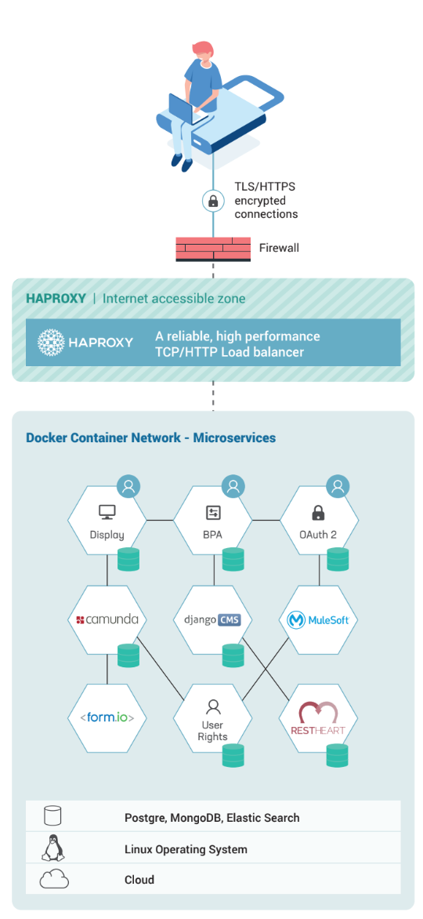
Digital public good to be considered to enable the EPR
Registration BB scope
Notes:
Standardized, plug and play to interconnect external systems with OpenAPI.
IM is like a glue to connect different systems.

